Slide 1


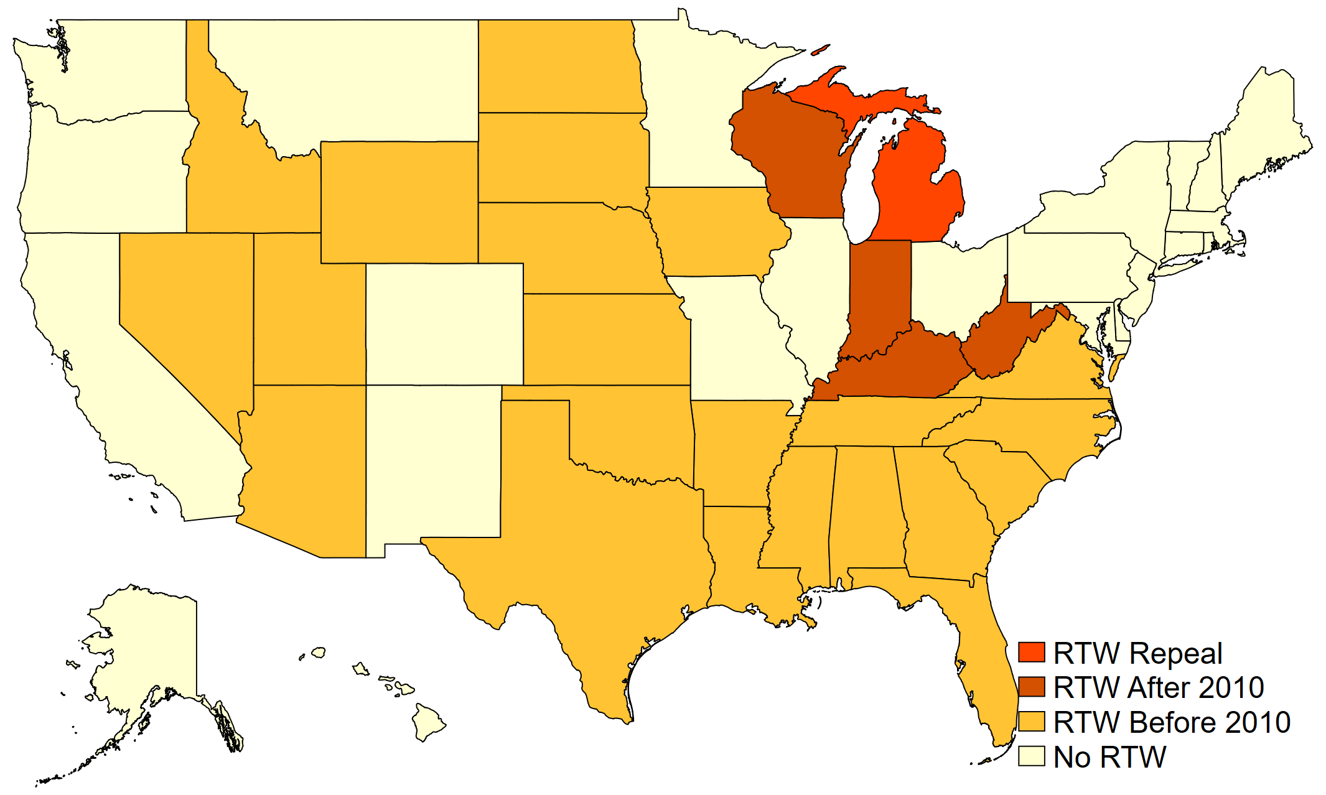

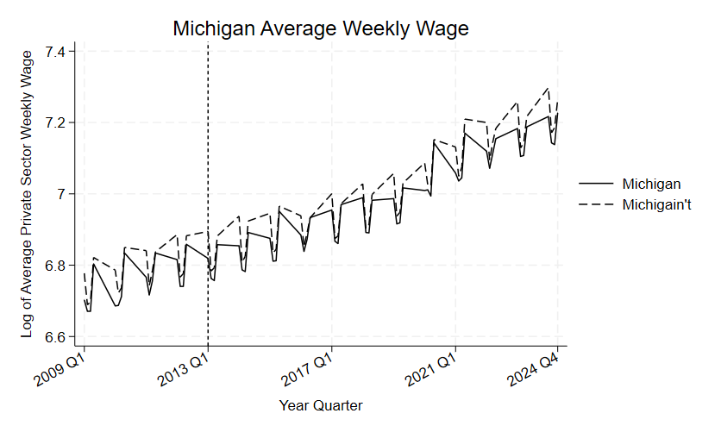
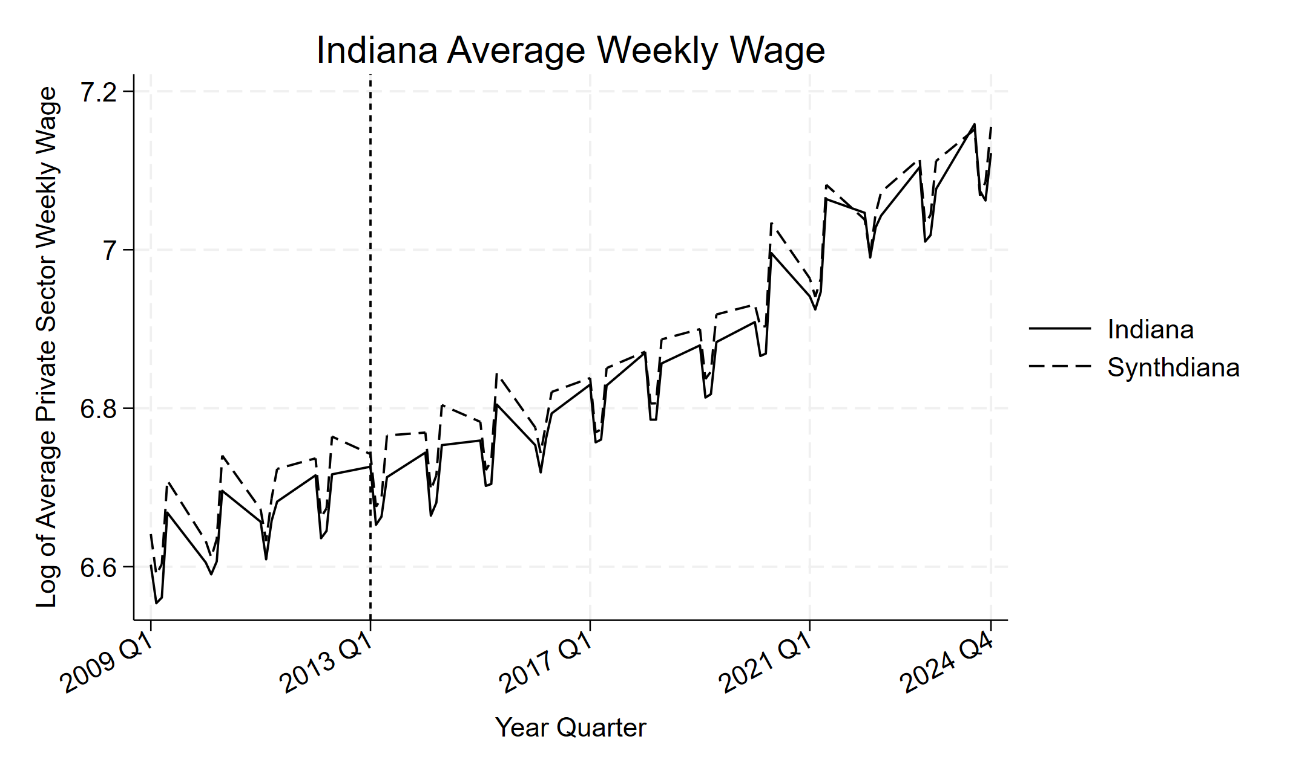
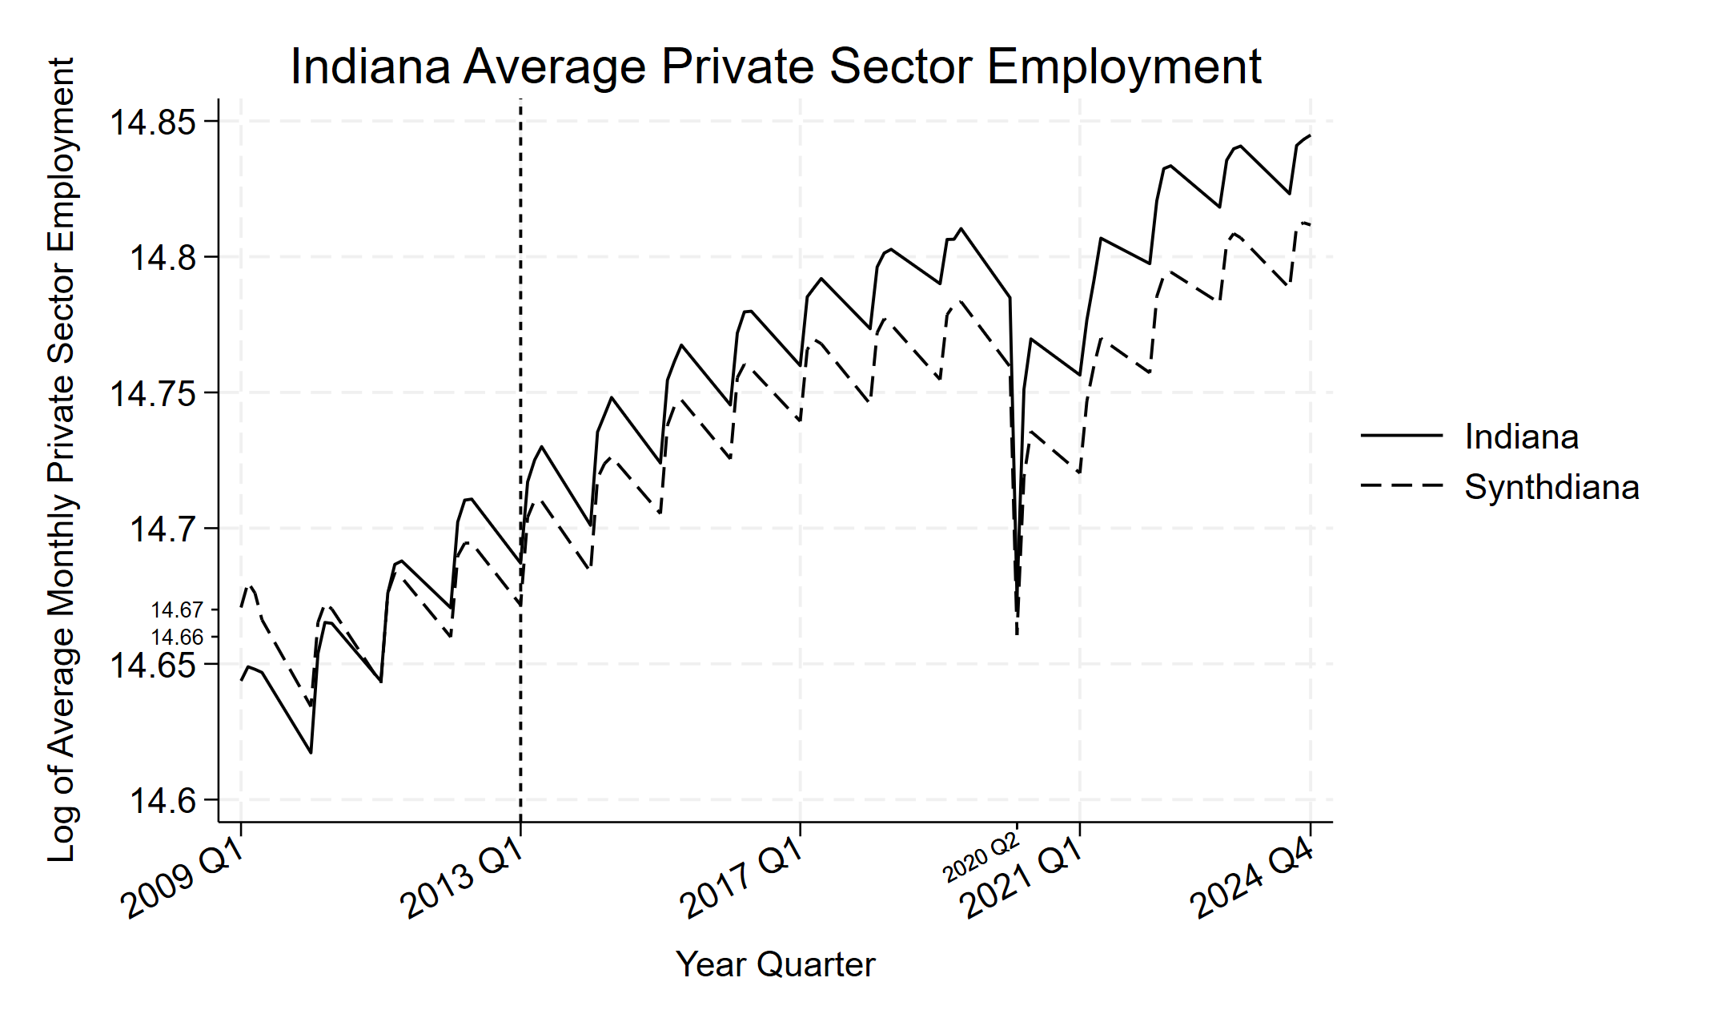
Right for Workers? Right-to-Work’s Effects on Labor Market Outcomes in Michigan and Indiana
Charles Vroman, MPP Candidate
Special thanks to Dr. Marty Jordan, Dr. Cory Smidt, and my classmates in the 2026 MSU MPP cohort
Introduction
After adopting Right-to-Work, Michigan and Indiana saw reduced private sector wage growth, and Indiana saw greater growth in employment
My research question: “Does Right-to-Work lead to changes in wage and/or employment for private sector workers?”
Right-to-Work laws are bans on union security/fair-share agreements.
Difficult to isolate RTW effects from other pro-business laws they’re often passed alongside.
Supporters argue it leads to more business activity + employment. Opponents argue it causes weaker unions + lower wages.
There was a new wave of states adopting RTW in the Rust Belt after 2010, with MI and IN enacting RTW in 2012. This gives us an opportunity to study the effects of RTW in a new region.
Want more details? Scan here to read my policy brief →
Methodology and Results
Technical Details
The Synthetic Control Model estimates what a unit would look like without treatment, using weighted averages of untreated units.
Synthetic versions of the RTW states are made from the non-RTW states, and the outcomes are compared with the real states.
I created two synthetic controls, “Michigain’t” and “Synthdiana,” to test how wages and employment would have changed if either state hadn’t adopted RTW. Due to an inability to create a good pre-treatment fit for Michigan’s employment, it has been excluded.
In both Michigan and Indiana, we see somewhat stymied growth in private sector wages than if either state hadn’t passed RTW. In Indiana we also see higher employment, but also a much steeper drop in employment in Q2 2020 during the Covid-19 pandemic.
MI Wage
State | Weight
Alaska | 0.106 (10.6%)
New York | 0.238 (23.8%)
Ohio | 0.655 (65.5%)
IN Wage
State | Weight
Missouri | 0.546 (54.6%)
New Mexico | 0.212 (21.1%)
Ohio | 0.395 (39.5%)
IN Employment
State | Weight
Maine | 0.018 (1.8%)
Missouri | 0.811 (81.1%)
New Mexico | 0.002 (0.2%)
Ohio | 0.169 (16.9%)

